Slide 1
BART
Gary Kleiman
NESCAUM/MANE-VU
MANE-VU SIP Planning Meeting
June 12, 2006

Slide 2
BART Resource Book
Review of Regulations
BART Eligible Source List (to the extent possible)
MANE-VU BART Process and BART Workgroup Recommendations
  All eligible sources are subject to BART
  Presumptive levels of control
BART Technology Assessment and Other Resources
  M-V Assessment (EGU/ICI/Cement/P&P)
  Industry Assessments
BART Determinations (including visibility determinations!)

Slide 3
Visibility Determinations
CALPUFF (MM5 driven meteorology)
CALPUFF (NWS Observation driven met.)
2002 contribution and post-BART, if applicable
Workgroup still investigating metrics, but 24-hour maximum impact at each Class I areas against natural conditions seems likely
Sulfate, PM, and Nitrate will be calculated

Slide 4
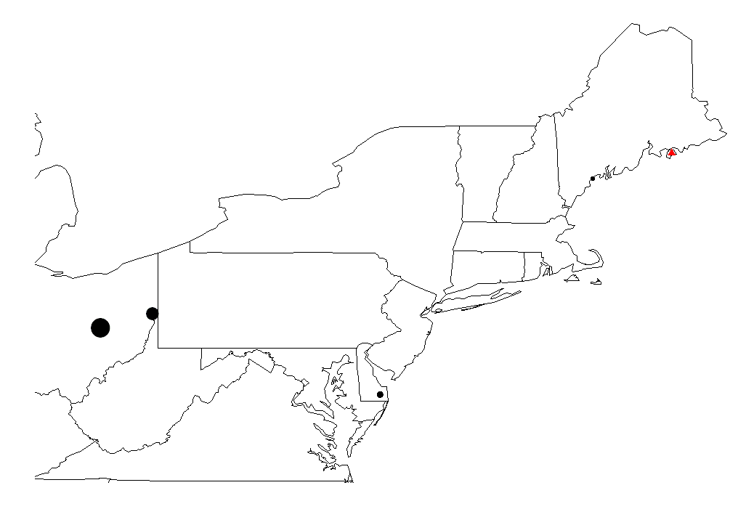
Acadia 24-Hour Max Day Impact
(relative to 20% worst natural
and baseline conditions)
1.748
0.533
0.665
Wyman St.
Acadia
0.905
0.186
0.324
0.220
Conesville
WH Sammis
0.075
Indian River
Change in Visibility (Δdv) relative
To Natural Background - Blue
Change in Visibility (Δdv) relative
To Baseline - Red
Notes:
An example of CALPUFF, source specific modeling results (courtesy of VT DEC) at Acadia…

Slide 5
BART Questions
Presumptive Levels for Cement Plants
Presumptive Sulfur Level for Fuel Oil
Threshold for Visibility Impacts
How to address engineering review versus visibility determination and other four factors
Do we want to ask FLMs to express their opinion?

Slide 6


